Slide 1
Course: Advanced Natural Language Processing (NLP)
Instructor: Dr. Atif Khan

Slide 2
Common NLP Tasks
Conversational Agents
Conversational agents, such as chatbots, simulate human-like conversations and are designed to interact with users.
They can handle numerous customer interactions, making it easier to manage large volumes of queries compared to hiring thousands of customer service representatives.
The examples commonly used for text-based and speech-based chatbots include:
Text-based Chatbots: Examples include chatbots like those used in customer service on websites (e.g., Drift, Intercom).
Speech-based Chatbots: Examples include Siri, Google Assistant, and Amazon Alexa.
Therefore, conversational agents are a very important application of NLP (Natural Language Processing).

Slide 3
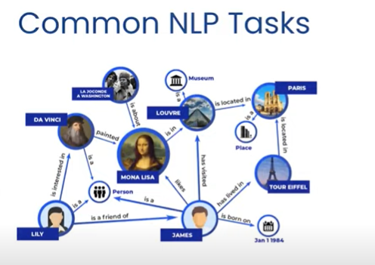
Common NLP Tasks
Knowledge Graphs and QA Systems. When you have a large database, you can create a knowledge graph by logically connecting its entities. Once the knowledge graph is established, it can be used to build a question-answering (QA) system.
Google’s Knowledge Graph is the largest in the world. It was built by connecting significant entities in its extensive database, which allows Google to provide immediate answers to queries such as "Who is the Prime Minister of China? “Google will immediately give you answer. This process is a crucial and somewhat advanced NLP task.

Slide 4
Common NLP Tasks
For example, Google’s Knowledge Graph connects various pieces of information about people, places, and things.
Suppose you ask Google, "What is the capital of France?" The Knowledge Graph enables Google to quickly retrieve relevant information by connecting entities such as countries and their capitals.
It understands that "France" is linked to the capital city "Paris," providing an immediate and accurate response.
Notes:
In the context of Google’s Knowledge Graph, entities are typically already linked in the background. When you issue a query like "What is the capital of France?" Google uses its pre-established connections in the Knowledge Graph to quickly retrieve and present the relevant information. This allows for faster responses because the relationships between entities, such as countries and their capitals, are already defined.

Slide 5
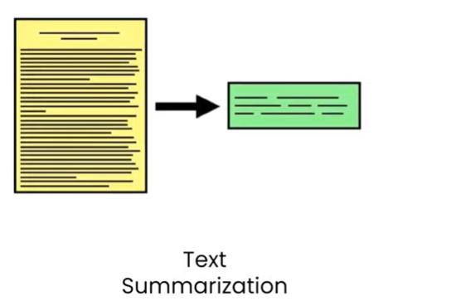
Common NLP Tasks
Text summarization is the process of creating concise summaries from lengthy texts.
For example, if you have a long news article, summarization techniques can extract the main points and present them in a shorter format, making it easier to understand the key information.

Slide 6
Common NLP Tasks
Topic Modeling is a fascinating task in Natural Language Processing. It involves analyzing large texts to extract and identify the main topics within them.
For example, if you have a lengthy document about cricket, topic modeling can help determine the key subjects discussed, such as the IPL, specific players, or matches.
To accomplish this, we use a machine learning algorithm called Latent Dirichlet Allocation (LDA), which will be discussed in more detail later.
LDA helps to uncover the underlying themes in the text by grouping words into topics based on their co-occurrence patterns.
Notes:
Latent Dirichlet Allocation (LDA) is a statistical model used to discover latent topics in a set of documents. It assumes that each document is a mixture of multiple topics and that each topic is a distribution over words.
LDA is a probabilistic model.It assumes documents are mixtures of topics, and topics are distributions over words.The number of topics is a hyperparameter that needs to be specified.LDA can be used for topic modeling, document clustering, and recommendation systems.

Slide 7
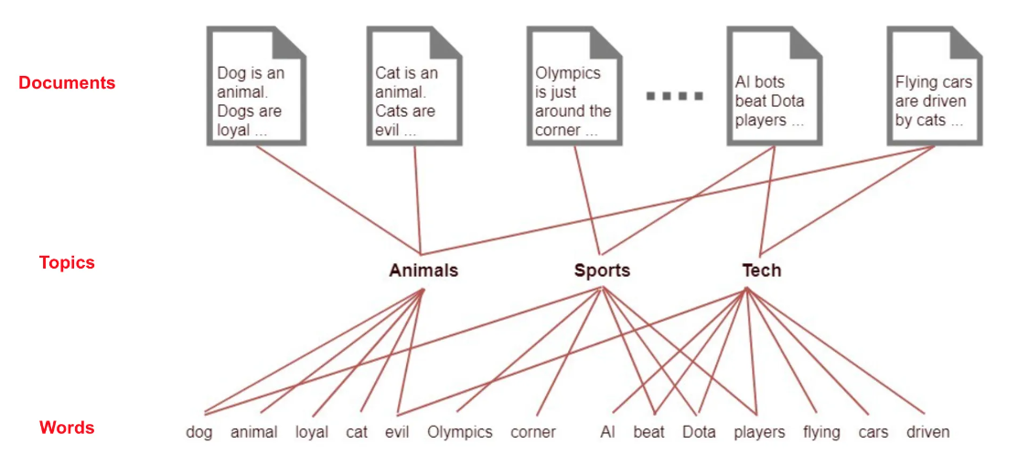
Example of Topic Modeling

Slide 8

Common NLP Tasks
Text Generation is a highly useful NLP task. It involves creating new text based on existing patterns or inputs.
For instance, when you type on a keyboard, text generation algorithms predict your next word based on your previous typing behavior.
This predictive text feature is valuable, especially when chatting with others, as it helps you type faster and more accurately by suggesting the most likely words to follow.

Slide 9

Common NLP Tasks
Spell Checking and Grammar Correction:
Spell checking and grammar correction tools are essential applications of NLP.
For instance, Grammarly is a popular tool that uses NLP techniques to enhance
your writing.

Slide 10
Spell Checking and Grammar Correction
When you type a sentence with typos or grammatical errors, Grammarly
automatically highlights these issues.
This allows you to correct mistakes and improve the overall quality
of your text.
By analyzing the context and structure of your writing, Grammarly
helps ensure that your sentences are both accurate and well-formed.

Slide 11
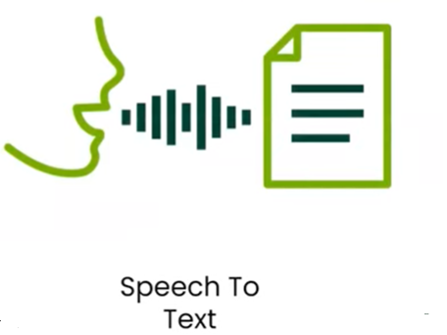
Common NLP Tasks
Speech-to-Text and Text-to-Speech are common NLP
tasks involved in building conversational agents.
For example, consider Siri:
Speech-to-Text: You speak into the device, and your spoken words are converted into text.
Text Understanding: The system processes the text to understand your request or query.
Text-to-Speech: The system then generates a response, which is converted back into speech for you to hear.
This technology is crucial for interacting with machines using natural language, enabling seamless communication between users and devices.

Slide 12
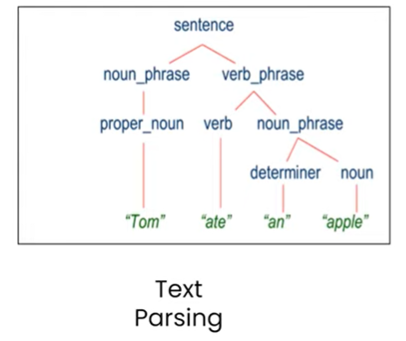
Common NLP Tasks
Text Parsing: This process involves grammatically breaking down a sentence to help machines understand its meaning.
By analyzing the structure of the sentence, text parsing allows us to interpret the roles and relationships of words within it.
This is a crucial preprocessing step in building chatbots, as it enables the system to accurately process and respond to user inputs.

Slide 13
Text Parsing
Text parsing involves analyzing the grammatical structure of a sentence to understand how words are related and what roles they play
Identify Parts of Speech: Parsing helps determine the parts of speech (e.g., nouns, verbs, adjectives) for each word in a sentence. For example, in the sentence "The cat sat on the mat," parsing identifies "cat" as a noun and "sat" as a verb.
Understand Relationships: Parsing reveals how words are connected. For instance, it shows that "sat" is the action performed by "cat," and "on the mat" describes the location of the action.
Sentence Structure: It helps in understanding the sentence structure, such as subjects, predicates, objects, and modifiers. This is crucial for interpreting the overall meaning.
Contextual Meaning: By breaking down the sentence grammatically, parsing aids in grasping the context and meaning, which is essential for tasks like responding to user queries accurately.
Notes:
the subject, predicate, and object are the basic components of a sentence. Here’s what each term means:
1. Subject:
The subject of a sentence is the person, place, thing, or idea that is doing or being something. It tells who or what the sentence is about.
Example: In the sentence, "The cat sleeps," the subject is "The cat" because it tells who is doing the action.
2. Predicate:
The predicate contains the verb and tells what the subject does or is. It describes the action or state of the subject.
Example: In "The cat sleeps," the predicate is "sleeps" because it tells what the cat is doing.
3. Object:
The object is the thing that is affected by the action of the verb. It often answers the question "what" or "whom" in relation to the verb.
Example: In "She reads a book," the object is "a book" because it is what she is reading.

Slide 14
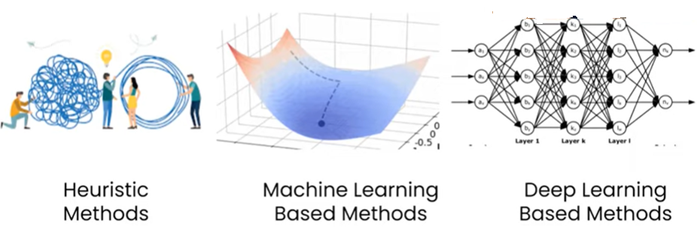
Approaches to NLP
NLP began in the 1950s, and for around 40 years, heuristic methods were used.
From the 1990s onwards, the machine learning era started and is still ongoing.
Around 2010, the deep learning era began, which also continues today.
All three methods are still in use, with each having its own impact.

Slide 15
Heuristic or Heuristic Technique
A heuristic or heuristic technique employs practical approach to problem-solving or self-discovery
Approach is not guaranteed to be optimal, perfect, or entirely rational.
It is often sufficient for reaching an immediate, short-term goal or approximation.
Characteristics of Heuristic Techniques
Shortcut or Quick Fix: Provides a simplified solution to a problem
Practical but not necessarily ideal
Heuristics in NLP
Rule-Based Approaches developed by NLP practitioners in the realm of heuristics.
Effective for certain types of problem-solving in natural language processing.
Notes:
heuristic approach means 'finding a workaround.' It means solving a problem by using a makeshift solution.

Slide 16
Heuristic Methods - Rule-Based Approach
Heuristic methods are practical solutions to problems, and they often rely on rule-based approaches.
This means that a set of predefined rules is used to address specific problems in a straightforward way, providing an efficient solution without requiring complex computations.
Example - Sentiment Analysis App To illustrate a rule-based heuristic, consider a sentiment analysis app. This app can determine if a text is positive or negative by counting the number of positive or negative words.
Although it's a simple method, it gives a basic understanding of the sentiment expressed in the text.

Slide 17
Heuristic Approaches
Simple Solutions in Heuristic Approaches:
The key advantage of heuristic approaches is that they offer quick, practical solutions.
In the sentiment analysis example, counting words gives an approximate result, which may not be as comprehensive as more complex methods but is useful for immediate needs.
Heuristic Approaches in NLP:
Emergence of various heuristic approaches over the last 5 years.
Three examples of widely used and famous Heuristic approaches. Regular Expressions, WordNet, and Open Mind Common Sense

Slide 18
Heuristic Approaches-Regular Expressions
Regular Expressions in Programming
Supported in almost every programming language.
A powerful tool for pattern matching and text manipulation.
A regular expression allows you to define a pattern and match text according to that pattern.
Use Case of Regular Expressions
HTML Tag Removal: are useful in practical application such as web scrapping. Regular expressions help remove HTML tags when scraping/extracting text from websites.
Salutation Search: REs Can be used to identify/search specific patterns like "Mr.," "Mrs.," "Doctor," "PhD," etc, within a paragraph.

Slide 19
Heuristic Approaches-Regular Expressions
Regular Expressions in Early NLP
Importance in Early NLP: Regular expressions were key tools for solving initial NLP problems.
Widely used by NLP practitioners to address text-processing tasks such as pattern matching and data cleaning
We'll explore regular expression usage in NLP in one section.

Slide 20
Heuristic Approaches-WordNet
Introduction to WordNet
WordNet: A well-known lexical database.
Purpose: Functions as a comprehensive lexical dictionary.
WordNet vs. Traditional Dictionaries
Traditional Dictionary: offer straightforward information such as word meanings, synonyms, and antonyms.
WordNet: Organizes and stores various types of relationships between words.
This organization helps to understand not just individual words, but how they relate to each other in various contexts.

Slide 21
Heuristic Approaches-WordNet
Example of WordNet Relationships
In WordNet, words are linked based on their semantic and functional relationships
Semantic Similarity: Words like "run" and "jog" are categorized as similar in meaning, as they describe similar activities.
Functional Relationships: Words like "run" and "shoes" are related or connected via functional relationship because shoes are used during running
These relationships are predefined and stored within WordNet to facilitate better language understanding.
Notes:
Hyponymy: "Jog" can be considered a type of "run." In other words, jogging is a specific kind of running, usually characterized by a slower, more relaxed pace compared to running.

Slide 22
Heuristic Approaches-WordNet
Applications of WordNet in NLP
Future NLP Applications: WordNet is a valuable resource for developing NLP applications. It is particularly useful for tasks such as translation, part-of-speech (POS) tagging, and other complex NLP systems.
Value: WordNet Provides structured lexical information to aid in understanding and processing natural language, enhancing the effectiveness of various NLP technologies.

Slide 23
Heuristic Approaches-OMCS
Open Mind Common Sense (OMCS) Overview
Initiation:
OMCS was launched in 1999 by the MIT Media Lab. This project was created to address the need for a comprehensive knowledge base that captures common-sense understanding.
Objective:
The main goal of OMCS is to build a large-scale repository of common-sense knowledge.
This knowledge base is intended to enhance artificial intelligence (AI) systems by providing them with a deeper understanding of everyday concepts and facts so that machines can build common sense.

Slide 24
Heuristic Approaches-OMCS
Purpose of OMCS
1. Create Knowledge Base:
OMCS focuses on gathering and storing common-sense knowledge, which includes everyday facts and relationships that people typically understand without much thought.
This knowledge is then compiled into a large database that can be used by AI systems.
Basic facts refer to universally accepted pieces of knowledge or simple truths that are generally known and understood by most people.
2. Community Contributions:
OMCS operates on an open-source model, allowing anyone around the world to contribute.
This open approach ensures a diverse range of inputs and perspectives, enriching the knowledge base.

Slide 25
Heuristic Approaches-OMCS
Common-Sense Knowledge
Common-sense knowledge consists of fundamental, everyday facts that people use to make sense of the world and make decisions. This type of knowledge is intuitive and often taken for granted.
Examples of common-sense knowledge include:
"Water is wet" – A basic property of water.
"People need to eat to survive" – A fundamental fact about human needs.
These examples illustrate how common-sense knowledge reflects basic, universal understandings that people naturally have.

